Slide 1
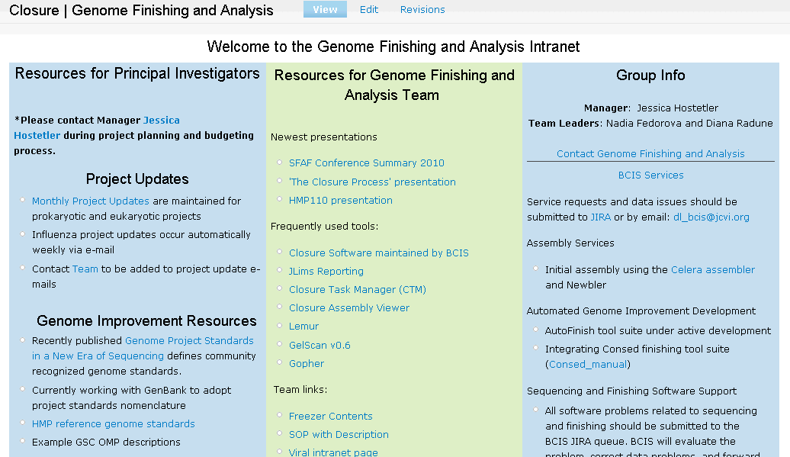
Intranet site: http://intranet.jcvi.org/cms/closure

Slide 2
Current Projects in Closure
Viral projects
Influenza
Human A – 10 collections - Sanger
Human B – none currently
Avian – 8 collections - NextGen
Swine-origin pandemic – 16 collections - Sanger
Rotavirus – 5 collections – Sanger and NextGen
Coronavirus
Bat - NextGen
Canine, feline, murine – 3 collections - Sanger
Human SARS - 3 collections – Sanger, testing NextGen
Human coronavirus – 2 collections - Sanger
Paramyxovirus
Metapneumovirus – 15 samples – Sanger, will test NextGen
Respiratory Syncytial Virus – 70 samples - Sanger
MMR
Measles - completed
Mumps – not yet started
Rubella – 16 samples - Sanger

Slide 3
Current Projects in Closure, cont.
Adenovirus – pilot phase – 10 samples - NextGen
Norovirus – preliminary analysis
Prokaryotic projects
U54 HMP project (non-contiguous finished) – 15 genomes
GSC E. coli project (improved high quality draft) – 27 genomes
GSC Strep project (improved high quality draft)– 7 genomes
GSC Acinetobacter project (non-contiguous finished)– 12 genomes
Eukaryotic projects
Follow-up analysis of few past projects
Other projects
Several fungal mitochondria genomes
Single cell SAR86

Slide 4
Genome Finishing and Analysis Team
Jessica Hostetler
Manager
Nadia Fedorova
Team Lead
Viral closure project management and
software testing
Influenza validation and submission
Small viral projects closure and validation
Ad Hoc analysis and troubleshooting
Diana Radune
Team Lead
Prokaryotic closure project management
Prokaryotic projects finishing
Software testing
Larry Overton
Research Associate III
Rotavirus closure and
validation
Coronavirus closure and
validation
Help with Influenza
closure and validation
Tamara Tsitrin
Research Associate II
Closure reactions for
all viral projects
Influenza closure
Kristina Dodson
Part-time help with
Paramyxovirus closure
Mary Kim
Research Associate III
Project Leader
Prokaryotic projects
Eukaryotic projects
Jaya Onuska
Research Associate II
Prokaryotic projects
Influenza closure

Slide 5
Viral Projects
General Closure Process
ASSEMBLY (currently for Sanger-only samples)
ANALYSIS AND EDITING
CLOSURE REACTIONS GENERATION
REASSEMBLY (currently for Sanger-only samples)
VALIDATION
SUBMISSION (Influenza only)

Slide 6
Viral Sanger Pipeline
Human Influenza (seasonal and pandemic)
Rotavirus
Coronavirus
Paramyxovirus
MMR
Adenovirus (1 test sample)

Slide 7
Influenza Sanger Pipeline Workflow
Post-sequencing process
Sequences are downloaded from JLims
Rename sequences according to Elvira naming scheme and flim in project db
Assembly (VAPOR)
Upload sequences in GLK, assemble, and upload contigs in project db
VAPOR is an automated assembly software suite
Samples are usually scheduled for assembly based on sequence count
Initial analysis (closure round 1)
‘Initial Manual Edit’ queue in CTM is a common depository for samples that are ready for closure
autoTasker
fluValidator
Editing in Cloe (if needed based on autoTasker and fluValidator outputs)
Closure reactions (tasks) assignment in CTM (if needed, tasks are assigned from either random primer plates or closure primer plates if available)
Sample is finished
Validation

Slide 8
Closure reactions and sequencing
CreateClosureRedoPlate.pl creates spreadsheet with detailed rxn information and makes manifest to upload to Jlims
Sanger sequencing
Reassembly (VAPOR)
Upload closure sequences in GLK, re-assemble from scratch, and upload new contigs in project db
Sample is finished
Post-reassembly analysis (closure round 2)
autoTasker
fluValidator
Editing in Cloe (if needed based on autoTasker and fluValidator outputs)
Custom primer design if needed (custom primers are not tracked in GLK, custom primers task assignment is done outside of CTM)
Validation

Slide 9
Closure reactions and sequencing
Jlims manifest will be created from a spreadsheet that is created manually by closure
Sanger sequencing
Final analysis
autoTasker
fluValidator
Sample is finished
Sample is not finished
Validation (Flava)
Checks for presence of start and stop codons, low coverage, ambiguities, frameshifts
Creates an ‘exceptions’ file that is manually inspected and converted to a ‘readme’ file that is attached to submission
Draft submission
Submission
Generate submission files
Update NCBI trace archive and assembly archive

Slide 10
Viral Sanger Assembly
Elvira is an umbrella suite of software that includes the following described tools
Flap is an actual viral assembler (originally designed for flu, hence the name)
/usr/local/devel/DAS/software/Elvira/bin/flap
is used for analysis of mixed samples
VAPOR is an automated pipeline for loading, assembling, and initial analysis of viral sequences
runs as a nightly CRON job so the samples are assembled as soon as they are sequenced
uploads sequences in GLK, assembles, and uploads contigs in project db
Also part of Elvira suite:
Lemur – a GLK web interface (Elvira metadata viewer)
Flurp / Rurp - a related pair of web applications which help load samples into the project databases.
plateTool - a graphical tool to support loading, viewing, and exporting of primer plates
autoTasker - An analysis tool that finds low quality features and suggests sequencing reactions to resolve them

Slide 11
Elvira Sequence Naming
IXJPA04T20E12HA525F
IXJPA04T20E12HA525F
IXJPA04T20E12HA525F
IXJPA04T20E12HA525F
IXJPA04T20E12HA525F
All samples are tracked as BACs in track, with a specific lib_id
All are tracked in the GLK as samples (track lib_id is GLK library_id attribute)
Segments are given a number
Primer plates are typically designed for each viral subtype and stored in GLK
Location on the primer plate denotes an amplicon
Primer coordinates
Notes:
-All samples are tracked as bacs in track, with a specific lib_id
-All are tracked in the GLK as samples
-segments are giving a number- easy to query
-primer version used, loading read and tasks
-well of primers on this plate
-segment and coordinates for which primers are designed

Slide 12
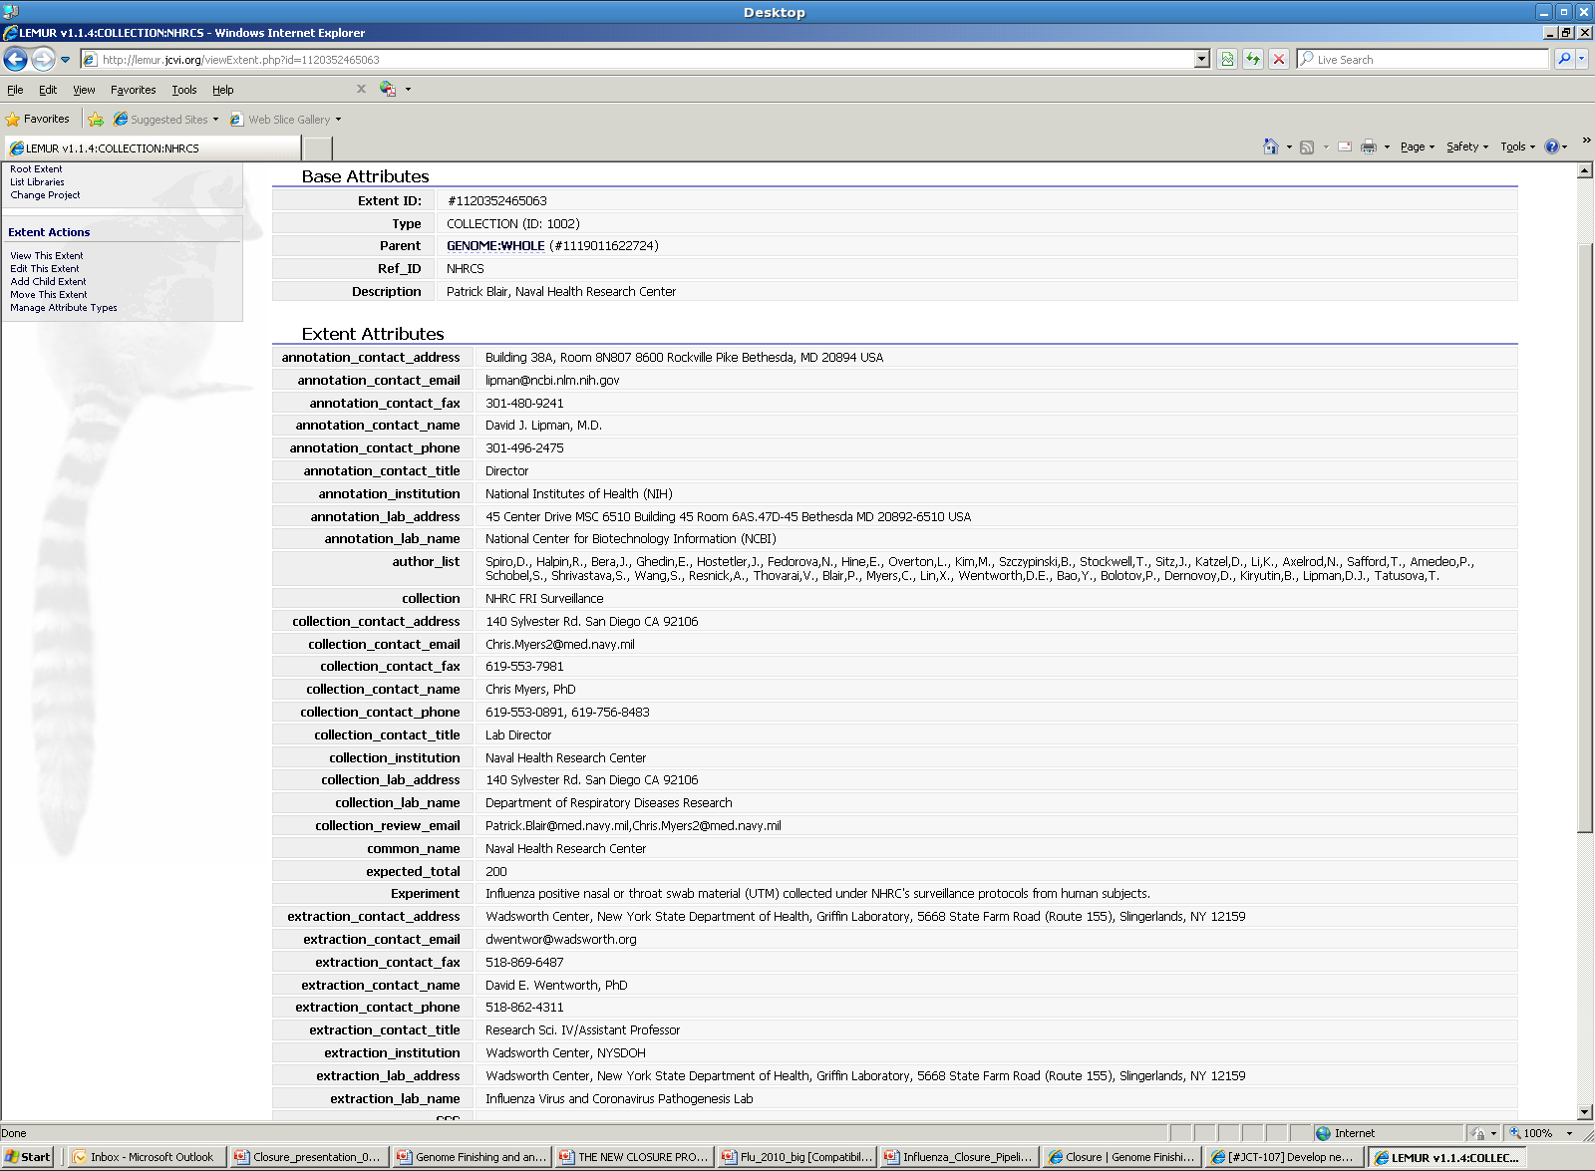
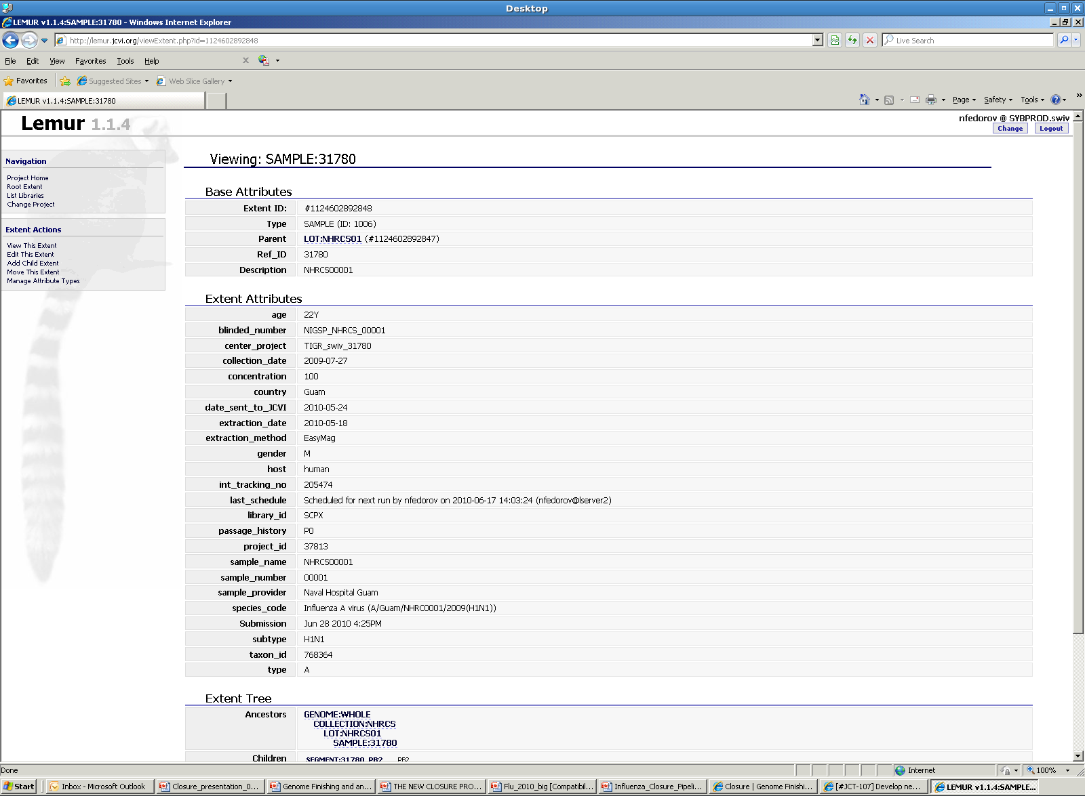
Lemur

Slide 13
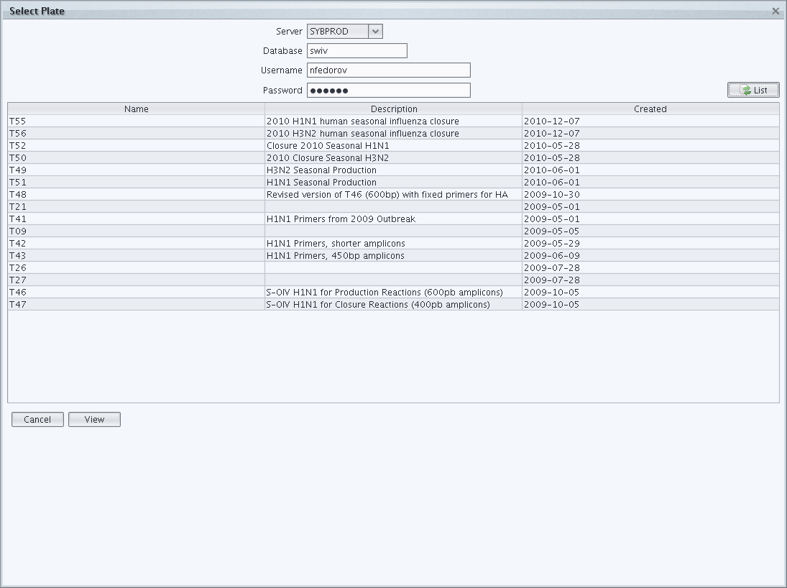
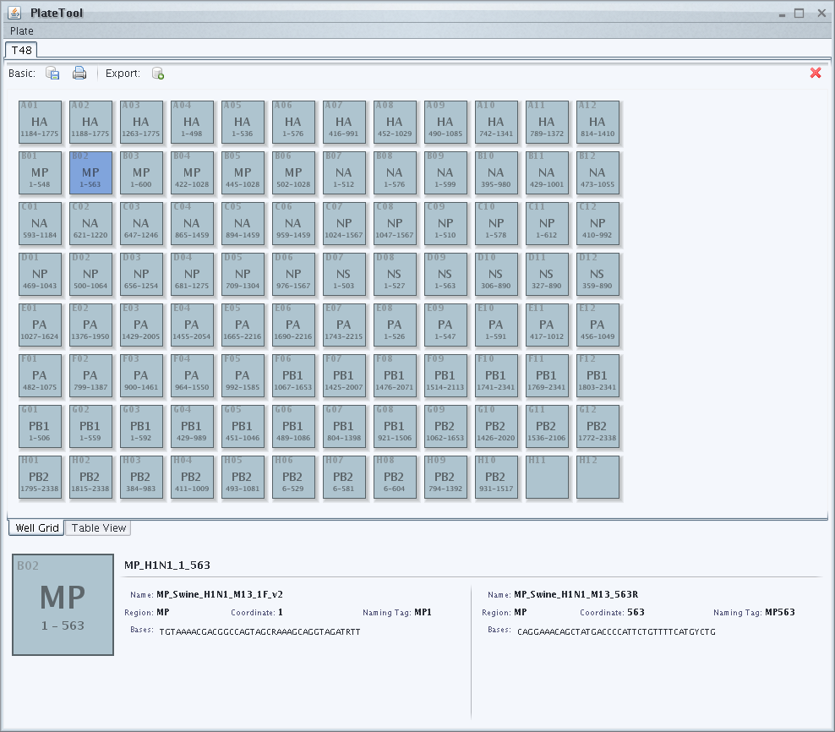
PlateTool

Slide 14
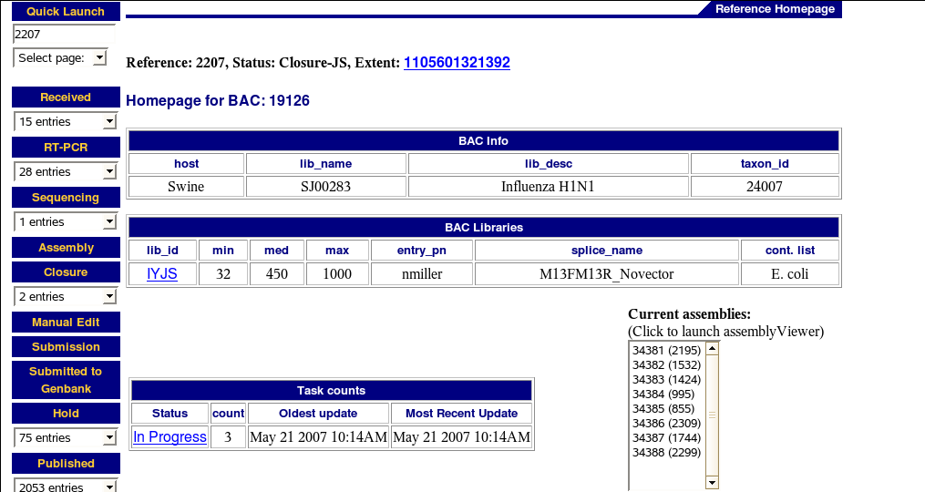
Closure Task Manager (CTM)
Every sample has a homepage in CTM
Every closure RA has a personal area to prevent sample collision
Samples are tracked from “Received” to “Submission”
Can be searched to make reports by samples or tasks (web-based and command-line)
Notes:
-Every sample has it’s own homepage in the closure task manager (pic)
-displays info such as sample info, subtype, lib_id, asmbl_ids and lengths, tasks, etc

Slide 15
autoTasker
autoTasker is a software package that is designed to analyze a sample or a set of samples, locate areas of low coverage, low quality, and validation errors and suggest sequencing reactions to resolve these areas.
autoTasker requires a formatted reference. autoTasker2 is designed to be reference-independent.
Current Sanger coverage requirements
Minimum 2x Sanger sequence coverage (autoTasker flags areas 1x and below)
Minimun 2x Sanger amplicon coverage (autoTasker flags areas 1x and below)
Complete list of autoTasker requirements - /fileshare/CLosureTeam/EukTeam/FLU/autoTasker Requirements
/usr/local/devel/DAS/software/Elvira/bin/autoTasker
autoTasker2 is currently being tested

Slide 16
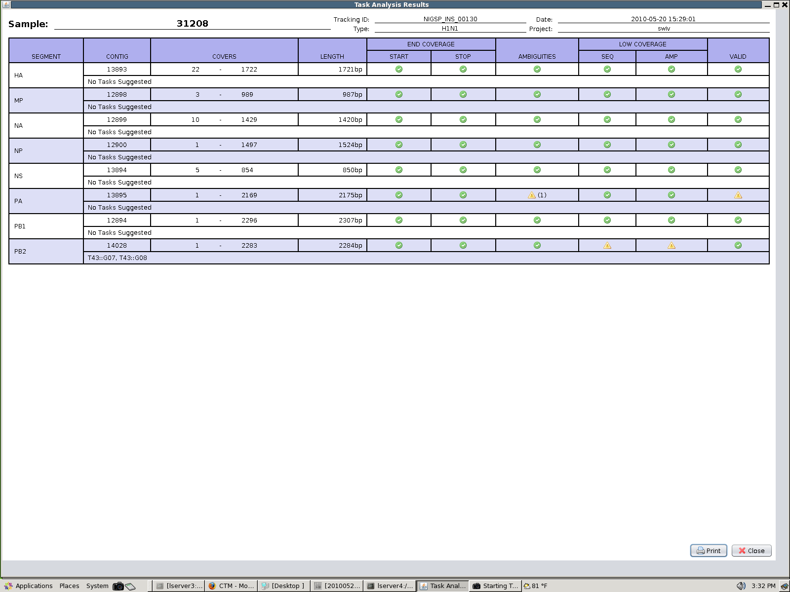
autoTasker
Valid
Verify validity
Suggests sequencing task in the format: plate_number::plate_well (T43::G07)
Flag - PA segment contains one (1) ambiguity
Warnings - PB2 segment contains low sequence and low amplicon coverage

Slide 17
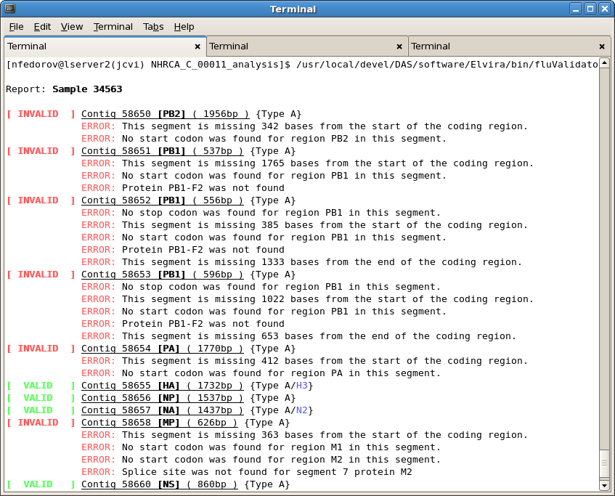
fluValidator
JCVI wrapper of NCBI validator
/usr/local/devel/DAS/software/Elvira/bin/fluValidator -D giv --sample 34563

Slide 18
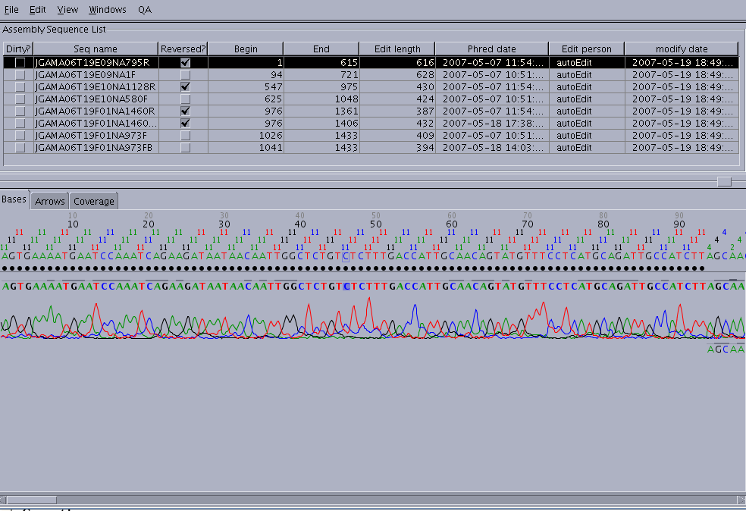
Coverage

Slide 19
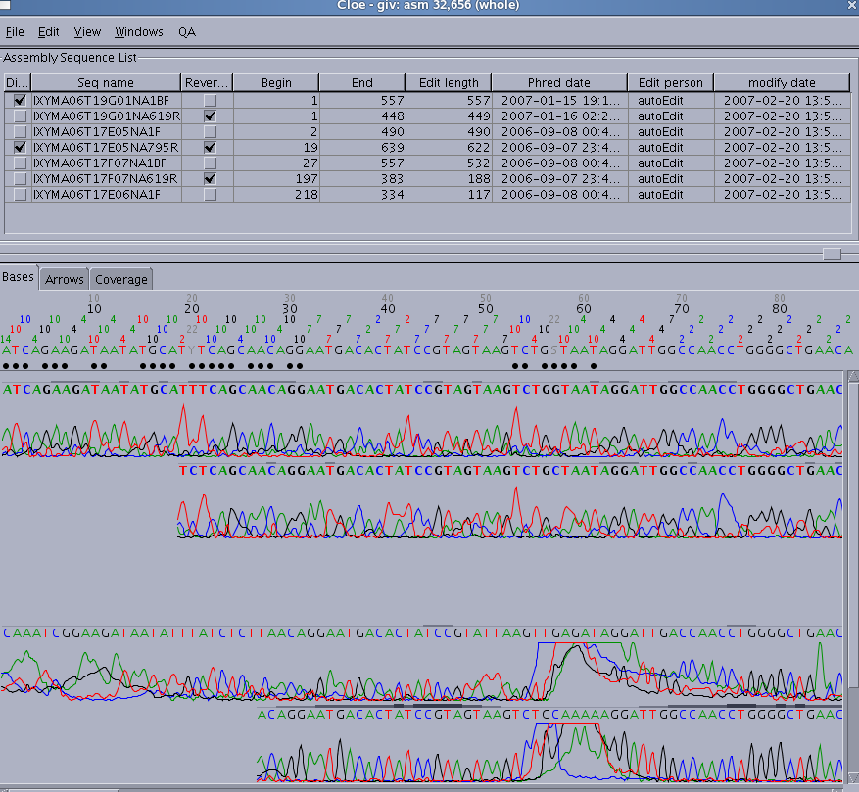
Quality

Slide 20
Viral NextGen Pipeline
Avian Influenza
Rotavirus (in the testing phase)
Coronavirus (in the testing phase)
Paramyxovirus (in the testing phase)
Adenovirus
Norovirus
Arbovirus (not in closure)

Slide 21
Influenza NextGen Pipeline Workflow
Assembly and post-assembly processing
Currently done by Tim and Danny
Deconvoluted reads are assembled with CLC mapping assembly
cas2consed builds Consed package (ace.1) and does coverage trimming (ace.2)
autoTasker and fluValidator
Files are deposited to /usr/local/projects/VHTNGS/sample_data_new/<db>/<collection>/<bac_id>/mapping/consed_with_sanger/
Sample does not have complete segments
Deprecated
Closure analysis (closure round 1)
Samples are binned based on closure effort needed to complete them *
‘Initial Manual Edit’ queue in CTM is a common depository for samples that are ready for closure
Editing in Consed (if needed based on autoTasker and fluValidator outputs)
Closure reactions (tasks) assignment in CTM (if needed) or custom primer design (if needed). Tasks are assigned from either random primer plates or closure primer plates if available. Custom primers are not tracked in GLK and custom primers task assignment is done outside of CTM
Draft Submission
Sample requires too much effort
NextGen Validation
Sample is finished

Slide 22
Closure reactions and sequencing
CreateClosureRedoPlate.pl creates spreadsheet with detailed rxn information and makes manifest to upload to Jlims (currently in transition)
Sanger sequencing
Reassembly with closure reads
Currently done by Tim and Danny
Sanger closure reads need to be uploaded to GLK prior to assembly
Deconvoluted reads are assembled with CLC mapping assembly
cas2consed builds Consed package
autoTasker and fluValidator
Files are deposited to /usr/local/projects/VHTNGS/sample_data_new/<db>/<collection>/<bac_id>/mapping/consed_with_sanger/
Sample is finished
Sample is not finished, but has at least 1 complete segment
Sample does not have complete segments
NextGen Validation and Submission
Only complete samples
autoTasker generates formatted fasta files
Send fasta files to NCBI
Deprecated
Draft Submission
autoTasker generates formatted fasta files
Send fasta files to NCBI

Slide 23
Viral NextGen Assembly
Search for all barcodes
Discard: reads w/o barcode and reads with more than one barcode.
Trim SISPA barcode and n-mer
all reads
set of uni-barcoded reads
de-novo assembly
tBLASTX against reference sequence database
Discard chimeric/non-viral reads
Assemble by segment (CLCbio)
Best consensus sequence(s) for each sample
(# of segments for segmented viruses,
1 for non-segmented viruses)
Best reference(s) from GenBank
CLC mapping for each technology
Update reference(s) with variations identified by multiple technologies
CLC mapping using updated reference(s) and all reads
For each segment:
BLASTN against a DB of full length segment(s)
Select best reference for segment(s)
mapping assembly

Slide 24
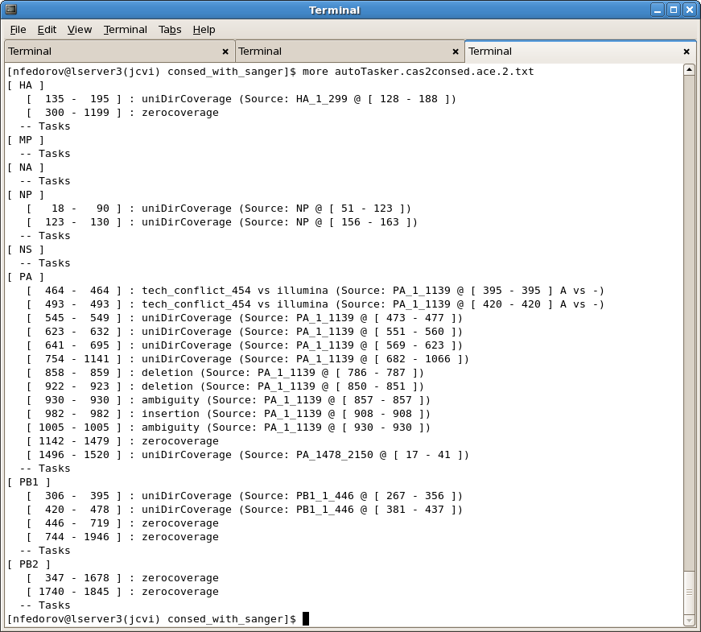
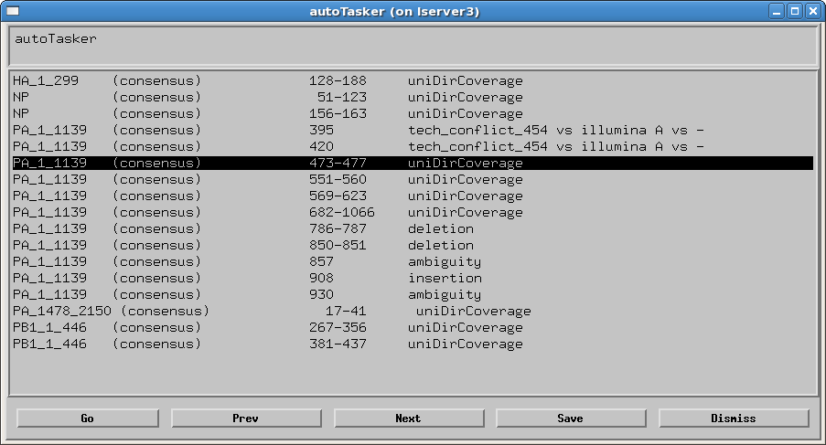
autoTasker for NextGen Samples
Since autoTasker is part of NextGen post-assembly process, html file (similar to Sanger pipeline) can not be generated.
Instead, autoTasker generates .txt file
in /consed_with_sanger/ directory
and .nav file inside Consed edit_dir.
Navigation file (.nav) can be opened
in Consed.

Slide 25
Closure Binning
Assembled NextGen samples are separated based on the amount of effort that is needed to finish a sample.
Binning is currently done manually by analyzing autoTasker.txt files. In the future, it will be part of autoTasker.
complete
needs edits
few regions
too many regions
failed/ deprecated
autoTasker exceptions:
none
autoTasker exceptions:
deletion
insertion
tech conflict
autoTasker exceptions:
uni-directional coverage
zerocoverage
(5 areas or less)
autoTasker exceptions:
uni-directional coverage
zerocoverage
(6 areas and more)
autoTasker exceptions:
all segments have quality exceptions
or no data available

Slide 26
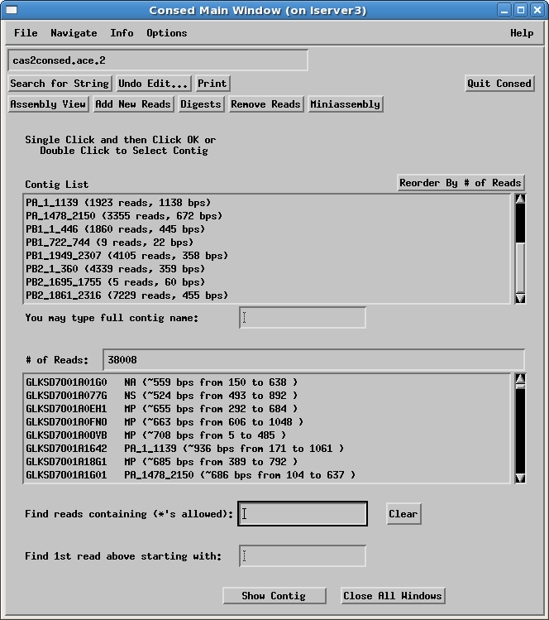
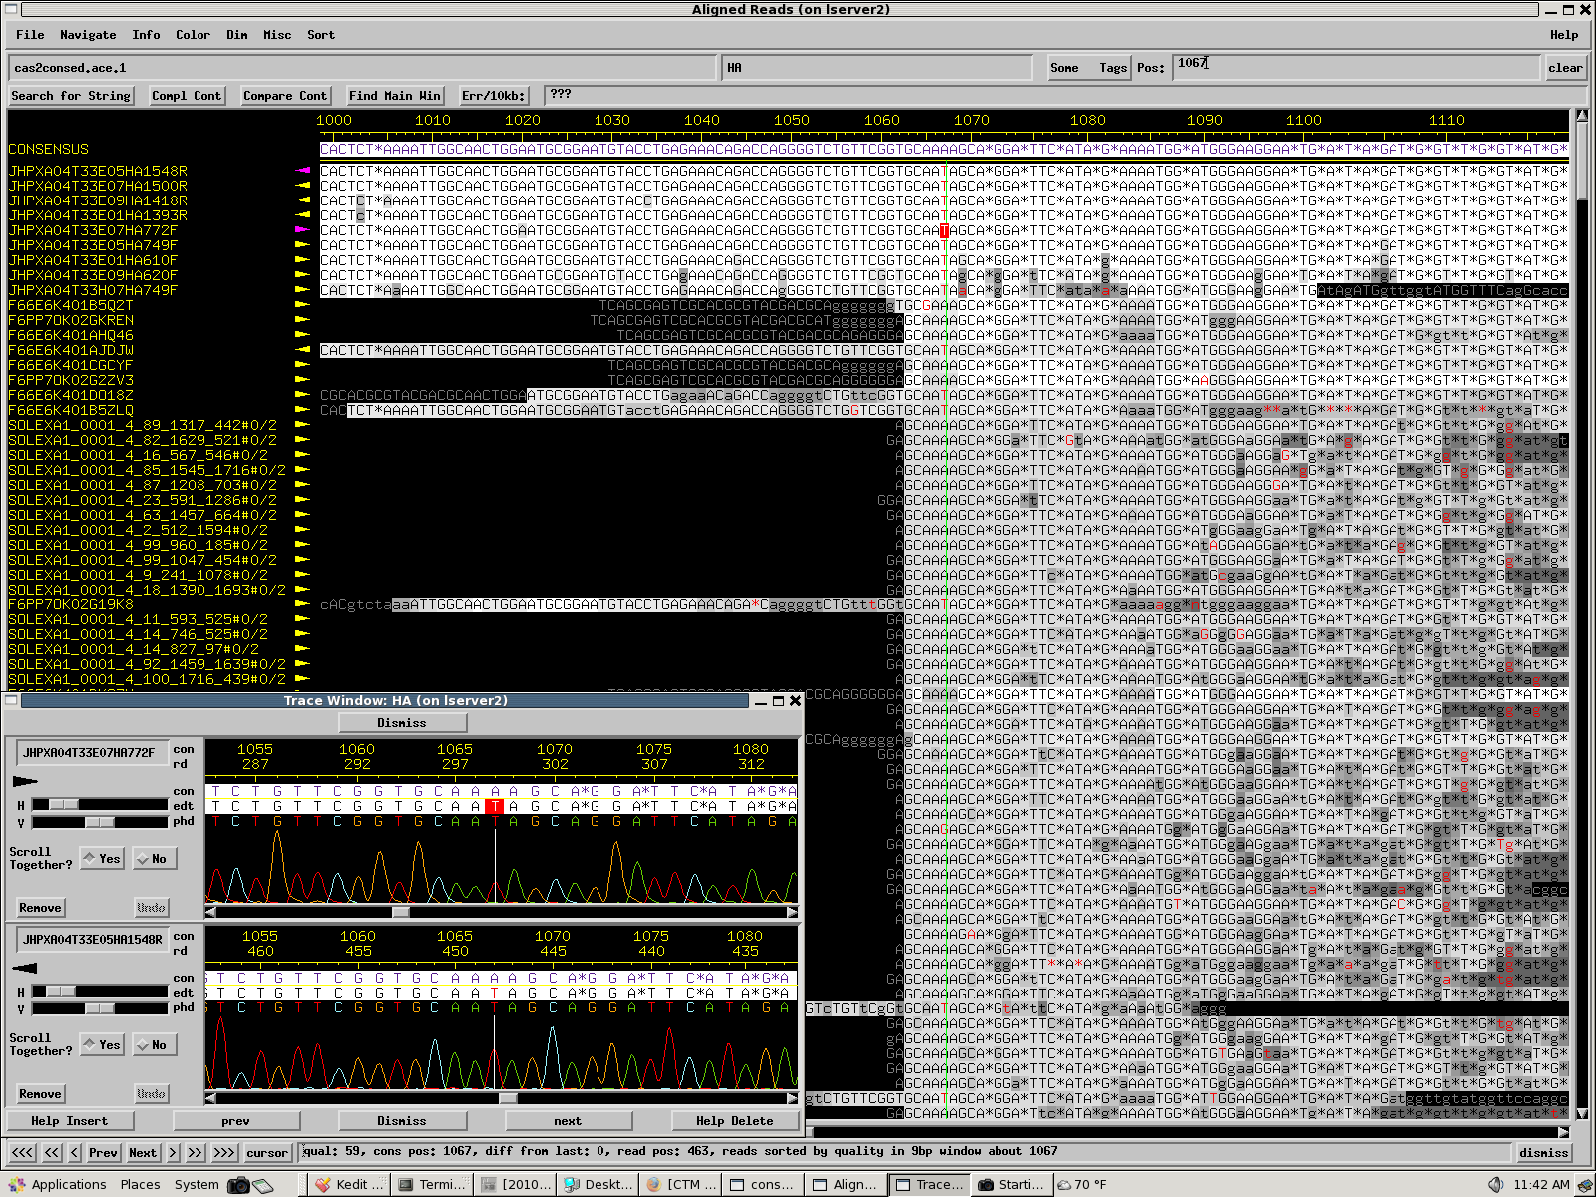
Consed
Consed operates on flat files; therefore, it is essential to save changes (edits) as a new file (ace.2, ace.3 and so on)

Slide 27
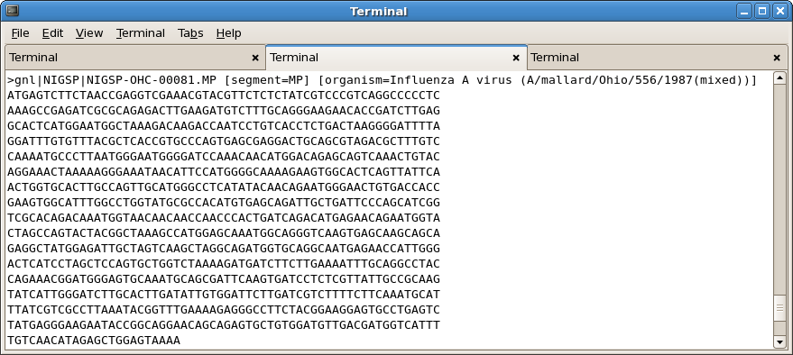
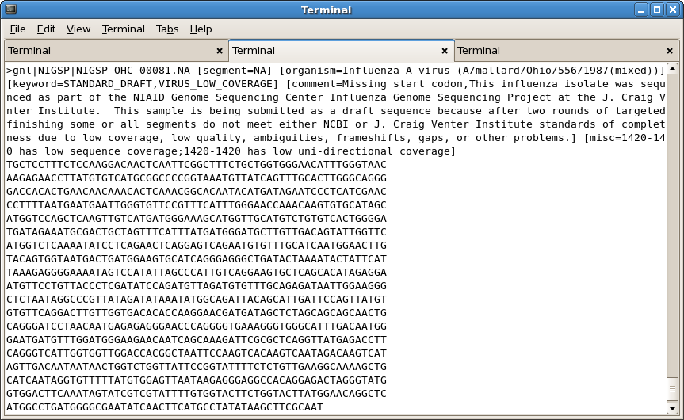
Submission of NextGen Samples to NCBI
All NextGen samples (complete and draft) and draft Sanger samples are sent to NCBI as fasta files with formatted deflines
SRA submission pipeline is in development
Samples are grouped based on db, collection, and status (draft or complete)
All submission files are kept locally in /usr/local/projects/VHTNGS/submission/<db>/<collection>/

Slide 28
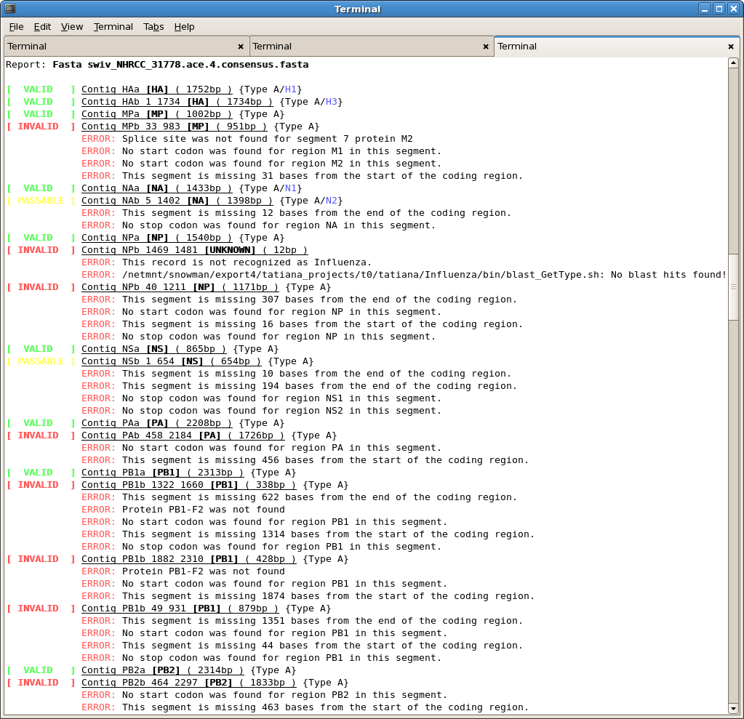
Analysis of Mixed Samples
Might be due to co-infection or contamination
Might be a mix of viruses of the same subtype or different subtypes (avian influenza, mixed human seasonal and pandemic influenza NHRCC/NHRCA)
NextGen sequencing approach is beneficial because it gives an unbiased picture of representation of each virus in a sample.
NextGen assembly pipeline for mixed samples is in development
Insertion of IUB codes in assembly consensus is in development

Slide 29
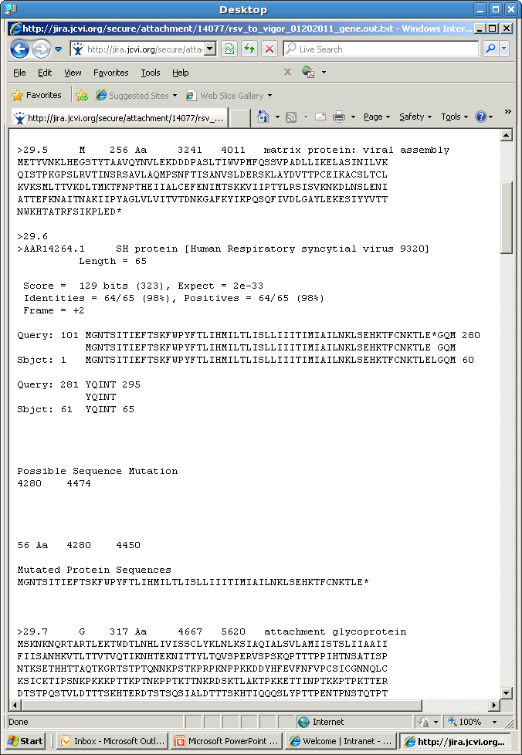
Non-Influenza Projects Pipeline Highlights
Quality and coverage
autoTasker can be run if formatted reference fasta file is deposited in /usr/local/projects/Elvira/etc/<db>/
autoTasker2 is reference-independent, now in testing
Validation
BLASTn can be used to check for coding regions
VIGOR (Viral Genome Orf Reader)
/usr/local/projects/GCV/Shiliang.dir/VIGOR.dir/
Has to be set up for every project
Annotation and submission
All viral genomes except Influenza are annotated at JCVI
Done by Viral IFX group

Slide 30
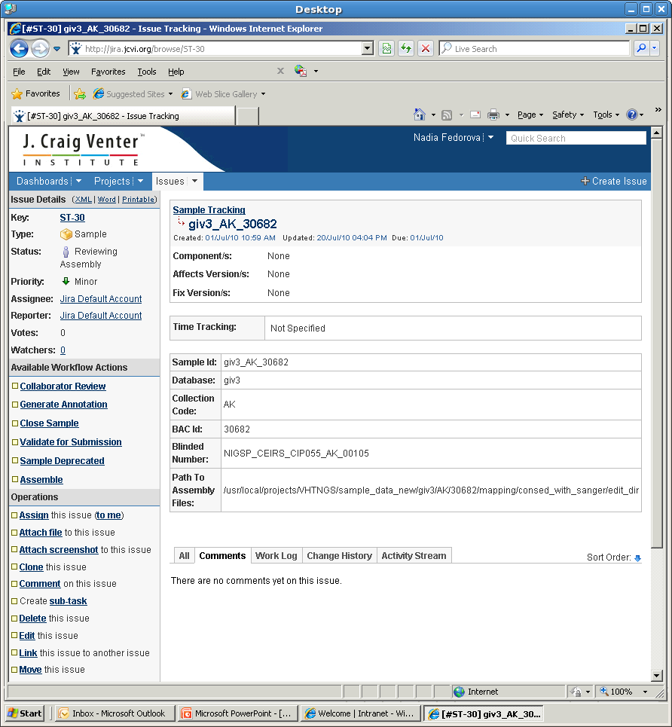
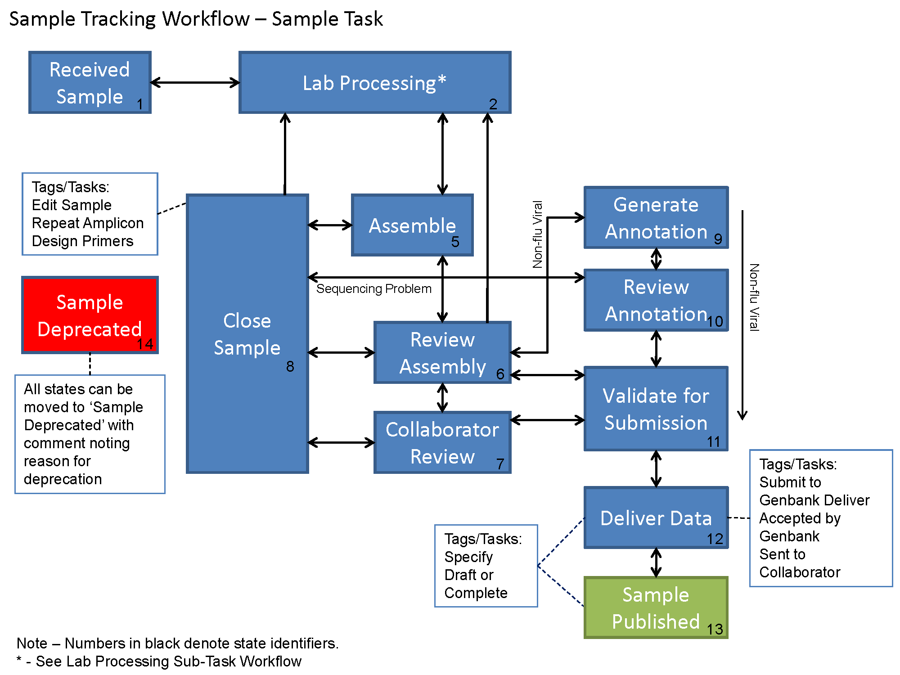
JIRA Sample Tracking

Slide 31
Viral IFX Development
SRA submission for NextGen viral samples
Migrating to JIRA Sample Tracking
Assembly of mixed samples (allowing for 8+ segments, phasing contigs, and consensus calling allowing ambiguities)
Automated assignment of 'Assembly Quality Status' (binning) (Complete, Needs Edits, Few Regions, Too Many Regions)
Tracking custom primers in GLK

Slide 32
Prokaryotic and BAC-based Eukaryotic Projects General Workflow

Slide 33
Genome standards definitions
http://www.sciencemag.org/cgi/content/full/326/5950/236
http://intranet.jcvi.org/cms/files/u43/Genome_standards_summary_JH.docx
Standard Draft - Biased sequencing or MDA samples
High-Quality Draft - 90% genome covered
Annotation-Directed Improvement - Likely most beneficial for eukaryotes
Improved High-Quality Draft - Usually adequate for comparison with other genomes
Automated and/or manual work involving manipulation of existing shotgun data or addition of automated directed reads to improve assembly
May contain undetectable misassemblies, low-quality regions, potential base errors
Unclosed areas not annotated
Noncontiguous Finished - Produces nearly complete reference genome for comparative purposes
A high-quality assembly subjected to automated and manual improvement
Resolution for almost all gaps, misassemblies, and low-quality regions
Full annotation of any areas not meeting Finished standard is required
Finished – For use in all detailed analyses; high-quality reference genome for comparative purposes
Less than 1 error per 100,000 base pairs
Each replicon assembled into a single contiguous sequence with a minimal number exceptions documented in the submission record

Slide 34
Genome Improvement is currently performed on 454 fragment, 454 paired-end and 454/Illumina hybrid assemblies. Future projects may be Illumina-only. Additionally, Illumina sequences are sometimes used for final consensus correction.
Standard draft/High-quality draft
Data is assembled using Celera Assembler or Newbler (CLC in future?)
Initial manual review
Scaffolding of contigs using CA scaffolder and Bambus
Manual join of overlapping contigs using Consed
Repeat identification and breaking of misassemblies using repeatFinder, printrepeats, Hawkeye scaffold viewer
QC assembly with asmcvg
Consensus quality analysis with CLC
AutoFinish pipeline (amplicon primer designer) is used to design custom primers for gaps and areas of low sequence coverage.
Notes:
34

Slide 35
Adding Sanger closure reads (if generated in previous step)
and gap closure in Consed
Improved- high-quality draft
Detailed manual review and lab work
Targeted gap closure – manual primer design, PCR and clone sequencing,
Repeat analysis and resolution
rRNA operon tagging
Ambiguity resolution and consensus editing
Remaining low sequence coverage analysis and resolution
Non-contiguous finished/Finished
Genome annotation and submission to GenBank

Slide 36
AutoFinish Pipeline Amplicon Primer Designer
Attempts to design primers for all primer design targets and retrieve primer design results. Attempts to design unique primers if reference is provided
ampliconPrimerDesigner -features <filename> -refFasta <filename> -projectCode <string> -strict|-loose|-custom <filename> -contigRefFasta <filename> -outputFile <filename>
ca2consed
Conversion utility that generates a Consed package from the CA input/output files. It uses a modified version of the asm2ace* conversion tool written by LABPR, Max Planck Institute for Molecular Genetics in Berlin.
ca2consed
.FRG -----> .ASM -----> .ACE -----> CONSED pckg.
CA assembly
asm2ace
Usage: /usr/local/devel/BCIS/assembly/CA/CA2ACE/ca2consed.pl

Slide 37
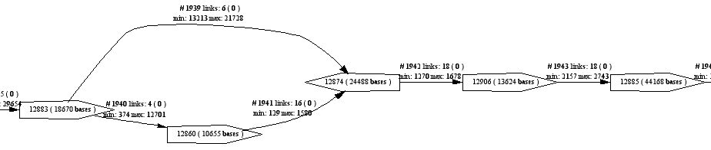
Bambus
Bambus is a db-independent scaffolder (bamboo is a db-based version)
creates a scaffold – a graphical representation of contigs and their relationship to each other
mate pairs (uses F&R mates, estimates length of gap based on known length of clone)
multiple insert sizes of libraries aid assembly and scaffolding

Slide 38
Celera Scaffolder
Part of Celera package that is run after the assembly is complete. Initial CA assembly also contains scaffold fasta file.
ca2scaff –i .asm –o output
>1113361014554 4 87631 88977
1113361014535 BE 27445 34.322 233.025
1113361014528 EB 20909 160.241 375.74
11113361014536 BE 8086 1152.397 253.303
1113361014537 BE 31191 0 0.0
>1113361014555 1 1315 1315
1113361014524 BE 1315 0 0.0
>1113361014556 1 1049 1049
1113361014525 BE 1049 0 0.0

Slide 39
Nucmer
Alignment tool that is used for:
To search for missed overlaps
To identify potential assembly problems (large repeats)
To align to reference if available
nucmer –o reference.fasta query.fasta

Slide 40
Coverage Checking Tools
asmcvg
asmcvg is a set of scripts that analyzes coverage.
finds regions of low sequence and clone coverage.
prok projects have adapted NextGen coverage standards. Sanger standards were always the same.
contigChecker
/usr/local/devel/DAS/software/JavaCommon2/nextGenContigChecker.pl
Originnaly developed for Influenza
finds areas of low sequence and amplicon coverage, high-quality differences (ambiguities), and non-random amplicon distribution.
Takes a long time to run on a prok genome
autoTasker2
Non-reference based version of autoTasker will work for prok genomes

Slide 41
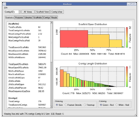
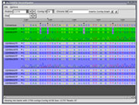
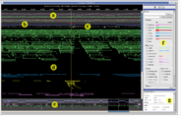
Hawkeye
Hawkeye is part of the AMOS suite of tools. It is used to interactively view and analyze genome assemblies.
Launch pad:
Contig view:
Scaffold view:
Installed in: /usr/local/packages/amos/bin/hawkeye
Hawkeye: a visual analytics tool for genome assemblies.
Schatz, M.C., Phillippy, A.M., Shneiderman, B., Salzberg, S.L. (2007) Genome Biology 8:R34.

Slide 42
Hawkeye
What assemblers can be used for Hawkeye?
The AMOS conversion utilities allow different types of output formats from commonly used assemblers to be converted into Hawkeye accepted files (Amos, Arachne, CA, Phrap, Newbler, TA, Velvet)
Usage:
/usr/local/packages/amos/bin/hawkeye sample.bnk/
Wrapper script to generate bank file:
/usr/local/devel/BCIS/assembly/tools/make_updated_bankfile.pl
.ace → .contig → .xml → re-formatted .xml → .afg → .bnk
1. convert ace to contig /usr/local/packages/amos/bin/ace2contig -i <ace_file> -o <contig_file>
2.run goBabmus goBambus -C <config_file> -c <contig_file> -m <mates_file> -o <prefix>
3.reformat .xml output /usr/local/devel/BCIS/assembly/tools/scaffold_parse.pl >-p <prefix> -I <xml file>
4.run toAmos and bank-transact /usr/local/packages/amos/bin/toAmos -m <mates> -ace <ace_file> -scaff <scaff_file> -o <prefix.afg> /usr/local/packages/amos/bin/bank-transact -c -b <bank_file> -m <prefix.afg>

Slide 43
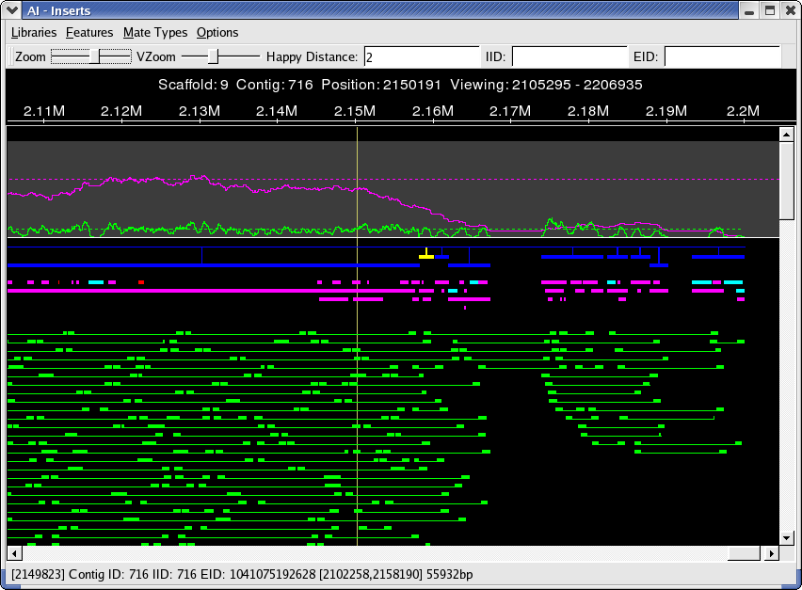
Hawkeye Scaffold Viewer
Toolbar
Position
Insert and
Read Coverage
Scaffold
Features
Inserts
Current Contig Position

Slide 44
CLC Genomics Workbench
CLC Genomics Workbench is used for de-novo genome assembly
CLC reference assembly is used for consensus correction of 454 only genomes with Illumina reads.
SNP/DIP Detection feature
Comparison of finished Y.pestis KIM D27 sequence to published KIM 10+ yielded 500-800 SNPs and INDELs. The majority of disagreements between strains were attributed to the INDEL problems in the homopolymer runs. To address the INDEL issue and correct consensus error, one lane of Illumina sequencing was added in CLC to the existing consensus that reduced SNP/INDEL error to 60.

Slide 45
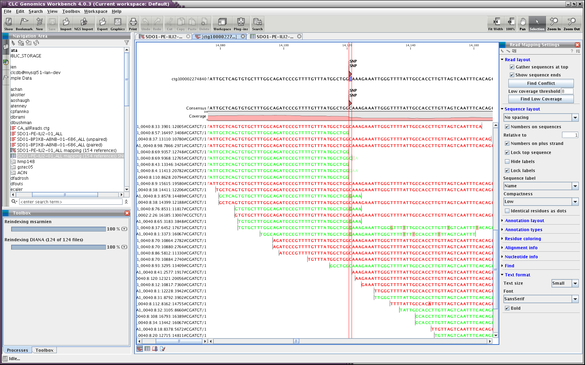
CLC Reference Mapping Assembly of Illumina Reads Against Genome’s Final Molecule

Slide 46
Repeat Recognition
Clone mate missasembly
RPT 1A
Contig 1
RPT 1B
Contig 2
Abnormal coverage depth
Gaps caused by repeats

Slide 47
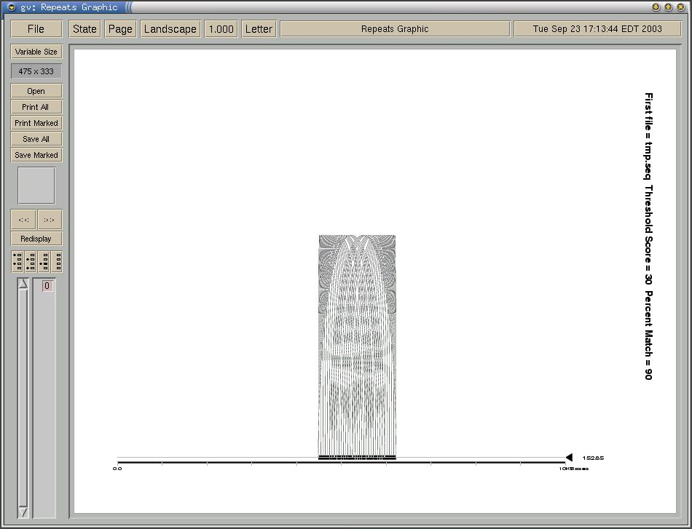
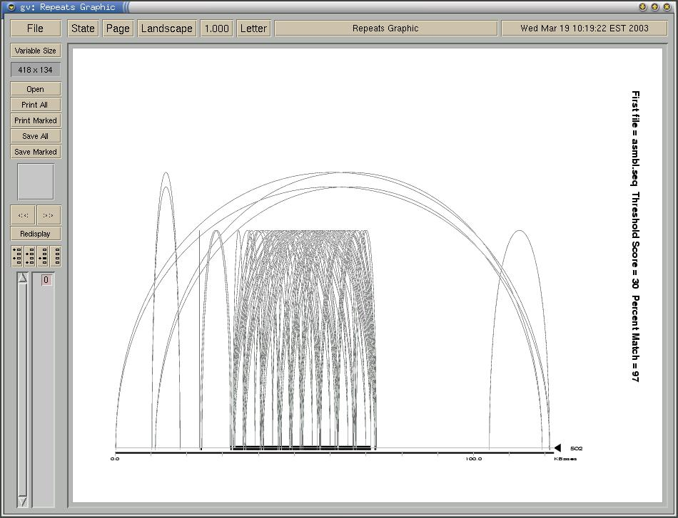
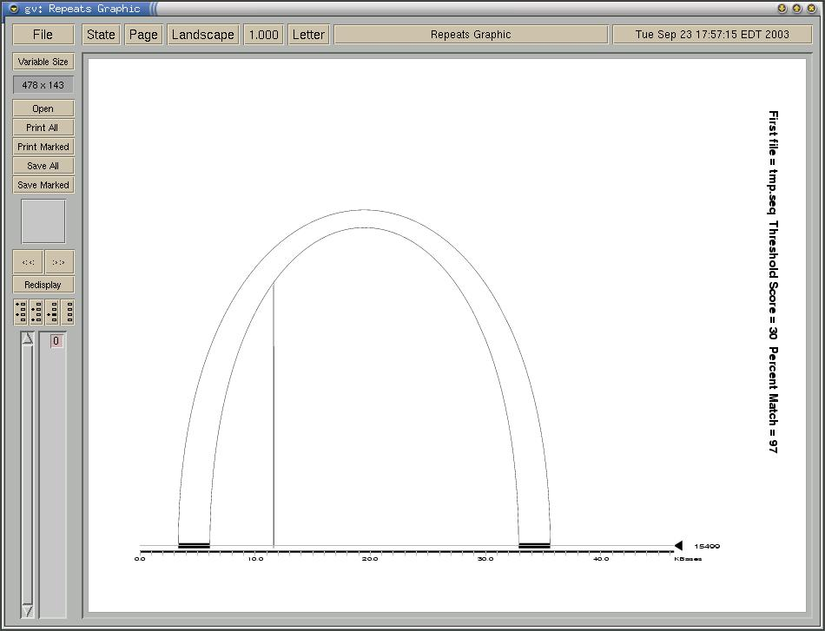
Repeat types
Short tandem repeat
Large multi-unit tandem repeat
Inverted repeat

Slide 48
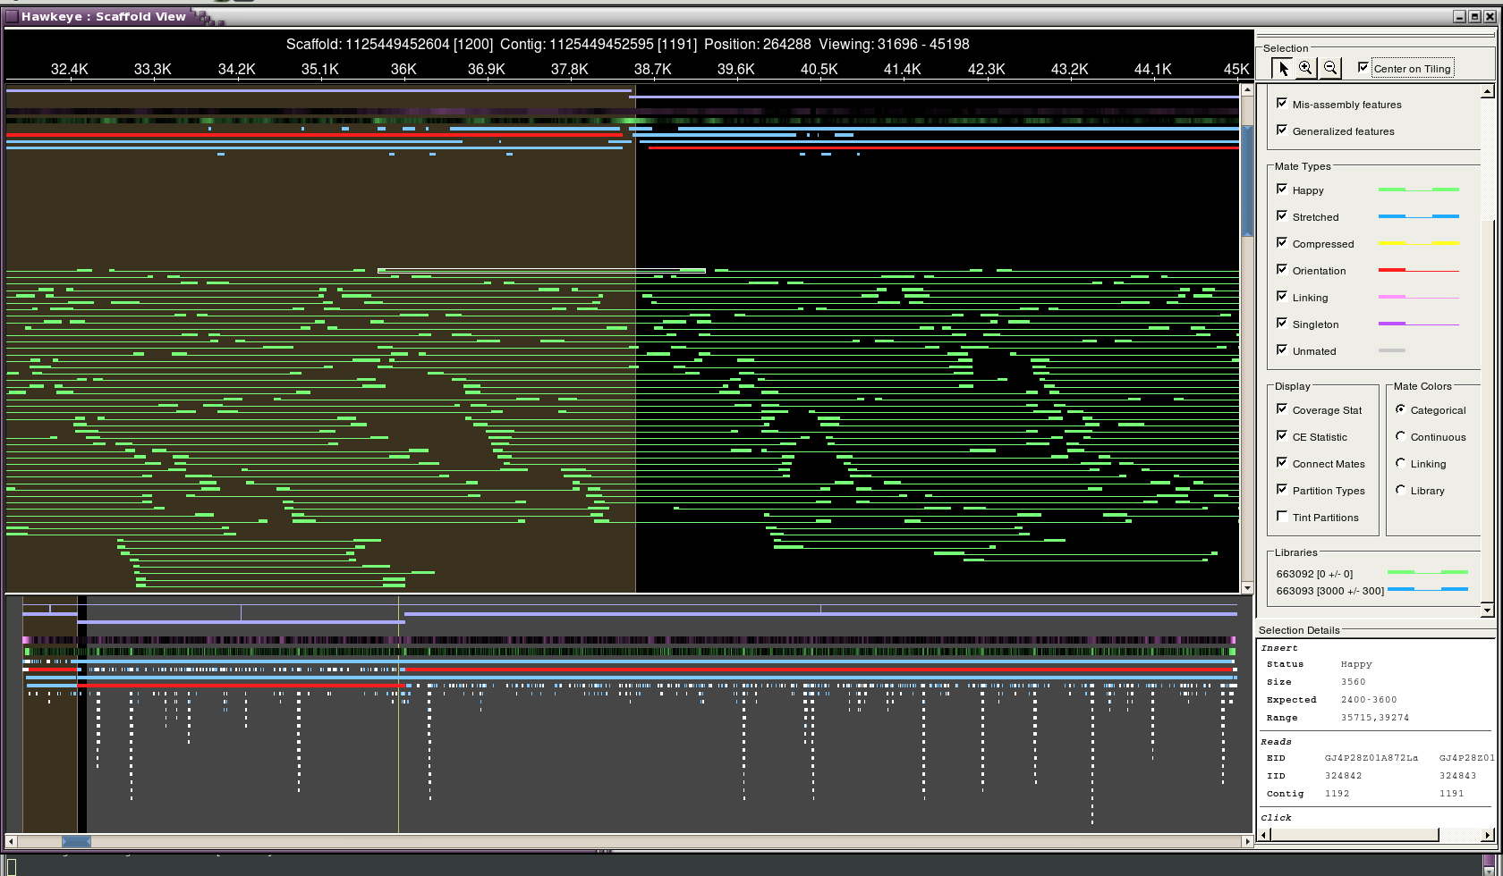
Repeat Detection in Hawkeye

Slide 49
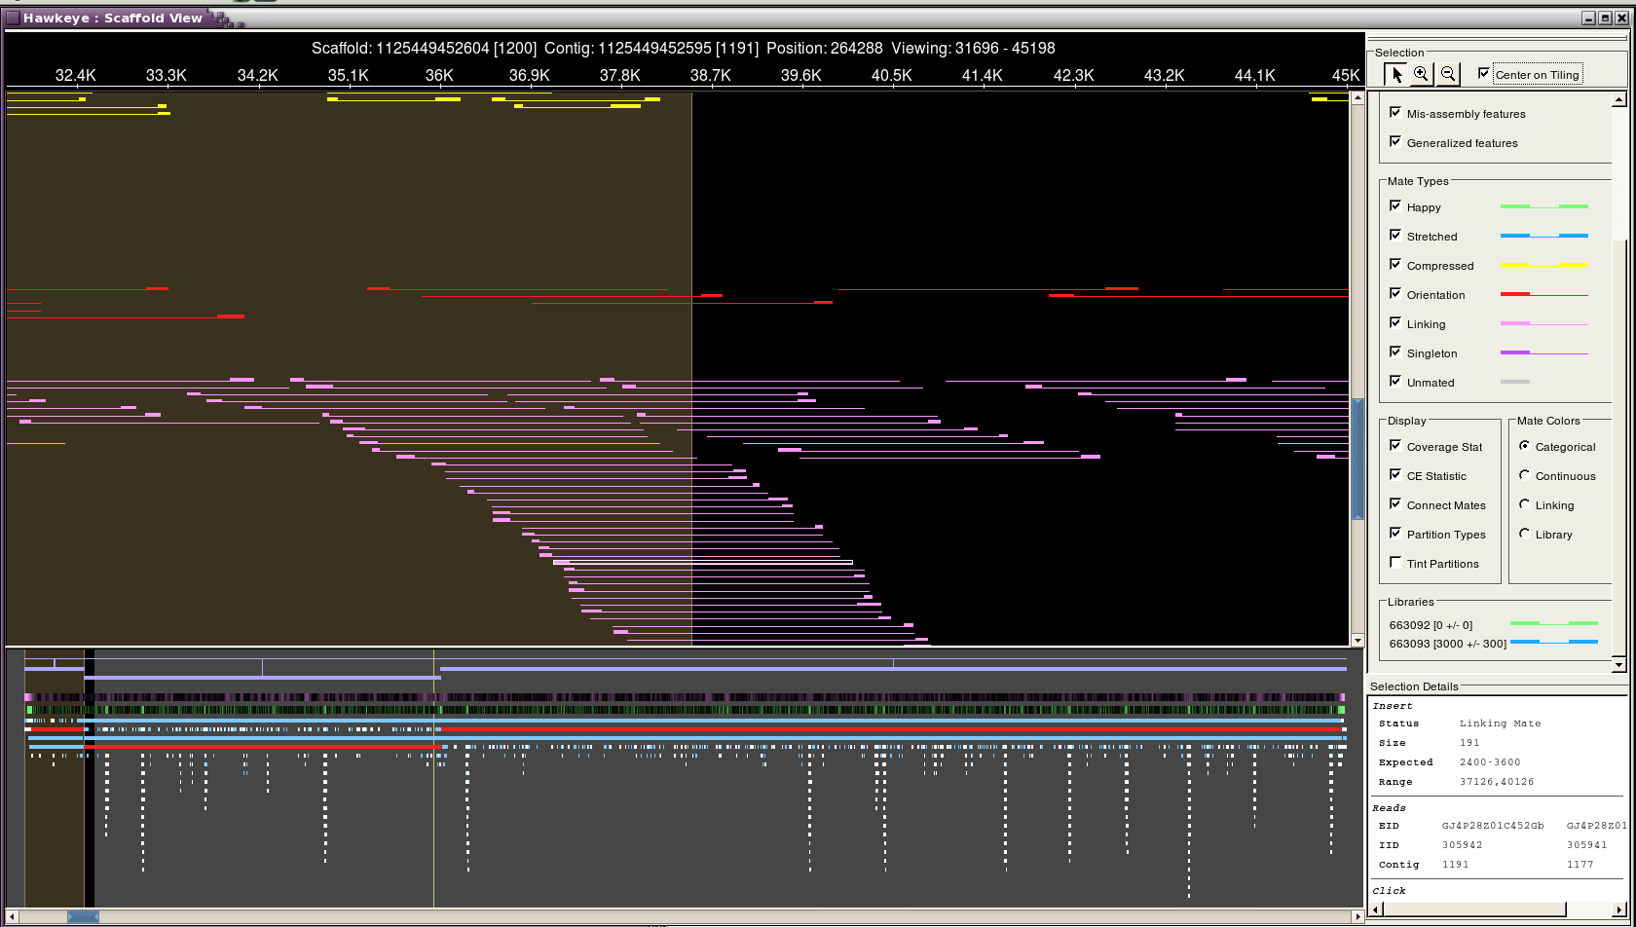
Repeat Detection in Hawkeye, cont.

Slide 50
Strategies for Dealing with Repeats
Repeat Identification
repeatFinder
Printrepeats
Scripts
find_missing_mates.pl will locate the contigs/coordinate of missing mates
can be used for gap closure
/usr/local/devel/BCIS/assembly/tools/find_missing_mates.pl
Molecular biology techniques
PCR
Transposons
Restriction Enzyme digestion
Manual reassembly (Consed mini-assembly and Jumpstart is essential)

Slide 51
repeatFinder
repeatFinder Analyzes sets of contigs for repeats greater than 50 bp and then groups these repeats into classes
repeatFinder calls REPuter
[Copyright© University of Bielefeld, Germany www.genomes.de; Used with permission]
The results are uploaded to the asm_feature table in project db and can be viewed graphically using the Closure Assembly Viewer and textually using the Feature pages.
Usage: repeatFinder [options]
Example: repeatFinder –o output.file –i 95 prefix_1.fasta
printrepeats
Will analyze a set of assemblies for repeats and produce both graphical representation of the repeats (threshold[s]) and repeats coordinate file (multifastafile.repetlist).
Usage: printrepeats [options] multifastafile

Slide 52
What is Jumpstart?
Jumpstart assembly is assembling other reads around existing contigs without changing the multiple alignments of the existing contigs.
Free sequences (closure reads)
Contig 1
Contig 2
Final Contig

